Slide 1

CUSTOMER PURCHASE PREDICTION
Using Machine Learning models to predict customer behaviour on e-commerce websites
ME781 DATA MINING/GROUP 3
203100068 MUDIT SAND
193100008 JAYKUMAR GUPTA
180100029 BURRA SRIHITH BHARADWAJ
170040106 BAVISH K
150040010 TANYA GUPTA

Slide 2
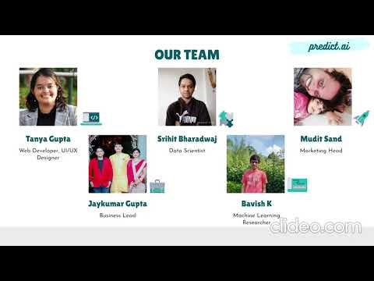
DEMO ON
www.predictai.design

Slide 3
TABLE OF CONTENTS
01
04
02
05
03
06
PROBLEM STATEMENT
PROJECT PLANNING CHARTS
Statistics to defend need for our project
Work distribution and timeline of work already done
OBJECTIVE AND DEFINITION
SNEAK PEEK OF WEBSITE
What do we aim to do and our Unique Selling Point.
Our demo website is ready. Have a look!
TECHNOLOGY AND ALGORITHMS
BUSINESS MODEL AND FUTURE SCOPE
Technology landscape assessment and machine learning algorithms used
Funding needed, revenue model and plans for project expansion

Slide 4
PROBLEM STATEMENT
27%
70%
52%
Y-O-Y GROWTH
Between Dec 2019 - Dec 2020 in ecommerce business due to COVID19
CUSTOMERS
Do their shopping online, while of the remaining, 30% see reviews online before buying in stores
SMALL BUSINESSES
Had to close shops in the same period, due to lack of technological support

Slide 5
PROJECT OBJECTIVE
COVID-19 has accelerated the transition from visiting physical stores to online shopping. Predicting customer behavior in the context of e-commerce is gaining importance. It can increase customer satisfaction and sales, resulting in higher conversion rates and a competitive advantage, by facilitating a more personalized shopping process.
At PREDICT.AI, we aim to HELP GROWING STARTUPS AND BUSINESSES utilize their customer data and build models for PREDICTING CUSTOMER BEHAVIOUR. Comparing models will give further insight into the performance differences on static customer data. Conducting descriptive data analysis and data visualisation will help our clients extract more value from data and make decisions to boost their customer satisfaction

Slide 6
PROJECT DEFINITION
UNIQUE SELLING PROPOSITION
& PROTECTION OF USP
BARRIER TO ENTRY &
EXISTING PRODUCTS/SERVICES
Easy to use software
Domain experts help
High accuracy models
Data protection and privacy
Branding of USP
AI Chatbot for support
Companies not wanting to share data
Companies building their own AI Teams
Google Analytics
Point Defiance Zoo
Aquarium
NTENT
CUSTOMER REQUIREMENTS
BUSINESS CASE
Accurate models
Good UX Design
Increasing revenue/campaign
24/7 Help and support
Target startups and small businesses
Publish conclusions from publicly
available data
Subscription model like Bloomberg
for companies
Testimonials and references from satisfied clients

Slide 7
TECHNOLOGY LANDSCAPE ASSESSMENT
01
02
03
Cirqueira D., Hofer M., Nedbal D., Helfert M., Bezbradica M. (2020). “Customer Purchase Behavior Prediction in E-commerce: A Conceptual Framework and Research Agenda.” Lecture Notes in Computer Science, vol 11948. Springer, Cham.
Kumar, A., Kabra, G., Mussada, E.K. et al. “Combined artificial bee colony algorithm and machine learning techniques for prediction of online consumer repurchase intention.” Neural Comput & Applic 31, 877–890 (2019)
Dennis Koehn, Stefan Lessmann, Markus Schaal,”Predicting online shopping behaviour from clickstream data using deep learning”,Expert Systems with Applications,Volume 150,2020,113342.
Chen, Zhen-Yu, and Zhi-Ping Fan. "Distributed customer behavior prediction using multiplex data: a collaborative MK-SVM approach." Knowledge-Based Systems 35 (2012): 111-119.
Patents
Published Literature
Jivox Kairos™
Predictive Intent Segments by Acxiom and AmEx
Open Libraries
NumPy
Pandas
SciKit-Learn
Matplotlib
Seaborn
Plotly
Pydot
XGBoost
Unittest/pytest
No proprietary libraries needed*

Slide 8
ALGORITHMS
KNN
Random Forest
PCA
Classification and clustering algorithms are used since the answer is a binary variable.
Data preprocessing is done to convert data to categorical or numerical data types, and keeping in mind ordinal, ratio interval data types.
The dataset is divided in 80:20 test-train ration and these algorithms are compared based on their accuracy on the test dataset.
Machine Learning
SVM
Logistic regression
Decision Trees

Slide 9
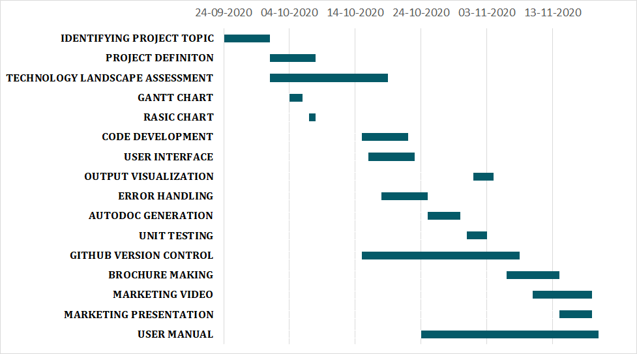
GANTT CHART

Slide 10
RASIC CHART
Tasks \ People
MUDIT
BAVISH
JAY
SRIHITH
TANYA
OBJECTIVE AND DEFINITION
A
A
S
S
R
TECHNOLOGY LANDS- CAPE ASSESSMENT
R
S
S
PLANNING - TIMELINE, GANTT, RASIC CHARTS
A
A
A
A
R
CONCEPTUAL DESIGN - MODEL/DATASET SELECT
A
A
R
S
A
CODE DEVELOPMENT PHASE 1
R
S
S
CODE DEVELOPMENT PHASE 2
S
R
S
S
MARKETING BROCHURE, PRESENTATION, VIDEO
S
S
R
USER MANUAL & PROJECT REPORT
S
S
S
R
S

Slide 11
BUSINESS MODEL
FREE
₹3k/month
₹30k/month
We plan to have a 3-tier business plan, with a subscription model depending on whether the client is established company, a small business or an individual doing hobby projects.
Hobby Project Tier
We have learnt a lot about analytics through our journey, and would like to help individuals, specially students
Start-Up Tier
Small businesses have less resources for analytics, and they will form a major segment of our customers
Business Tier
Established e-commerce companies usually have internal teams for this analysis, they will be interested in comparing ML models

Slide 12
BUDGET EXPENSES
₹30,000
₹10,000
₹20,000
₹10,000
Marketing
Web Development
Customer Service
Data Modelling
Marketing to e-commerce platforms through appropriate channels
A/B Testing and deploying the website and predict.ai platform
Setting up a team and ensuring client needs are met by providing 24/7 service
Collecting data and improving the accuracy of our model
₹70,000
Estimated expenditure for setting up our business

Slide 13
PROJECT TIMELINE
Work on the platform and improve model accuracy
Pilot testing with selected clients and implement suggestions
MAR 2021
OCT 2021
DEC 2020
JUN 2021
2022 ONWARDS
Presented as course project. ML model and website ready
Pitch to small startups and marketing efforts
Plan for official launch

Slide 14
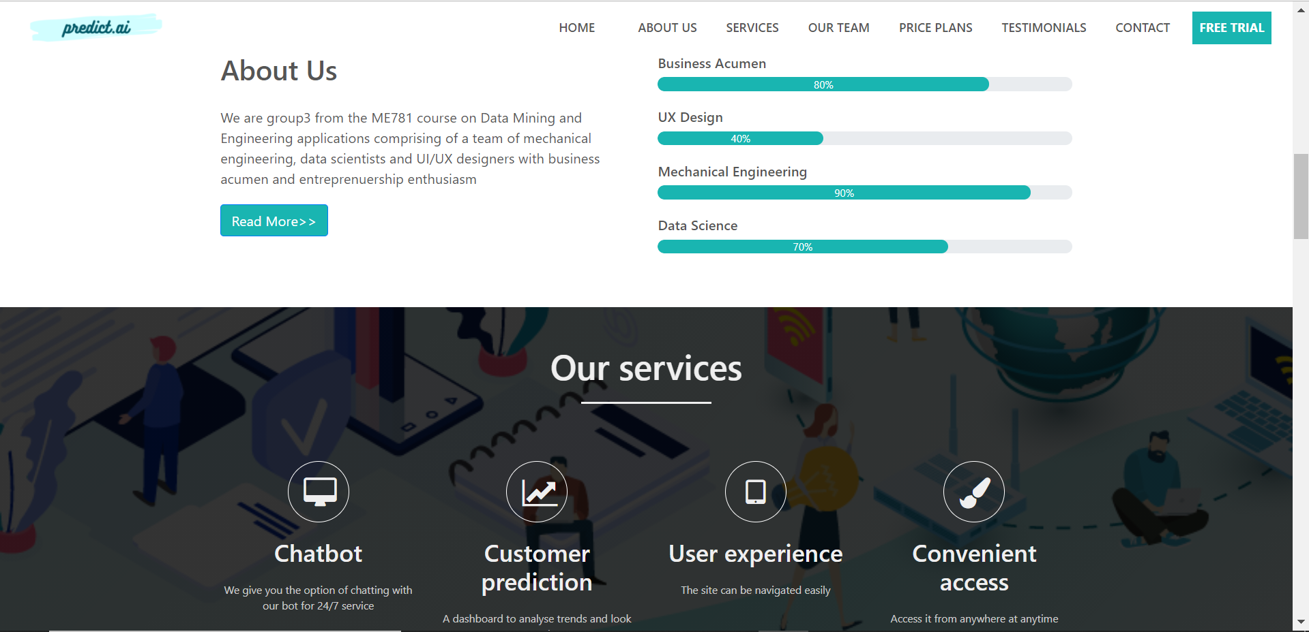
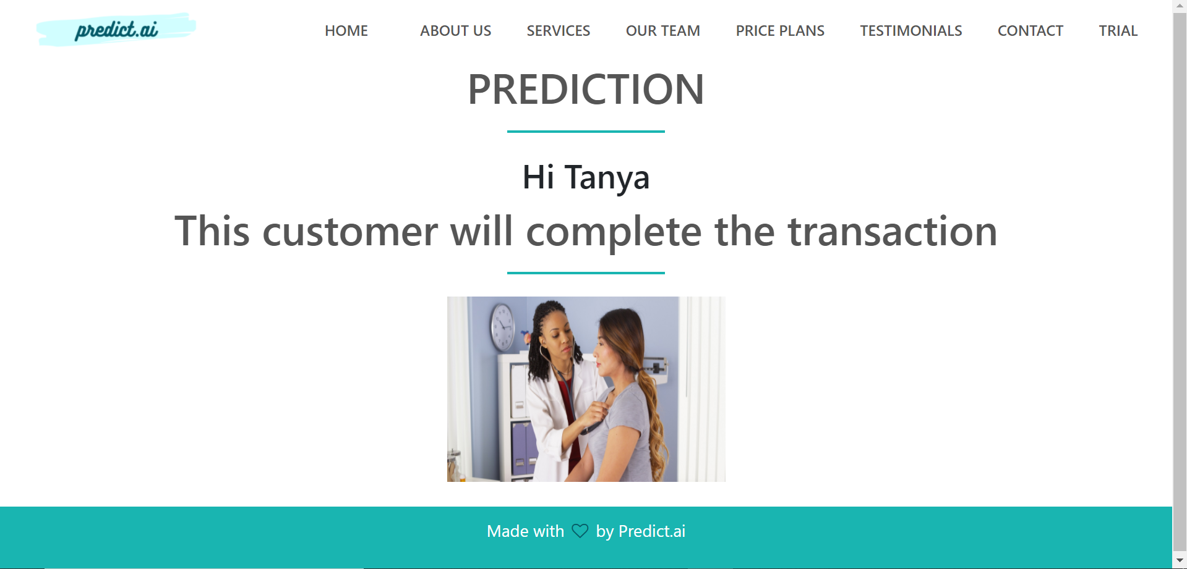
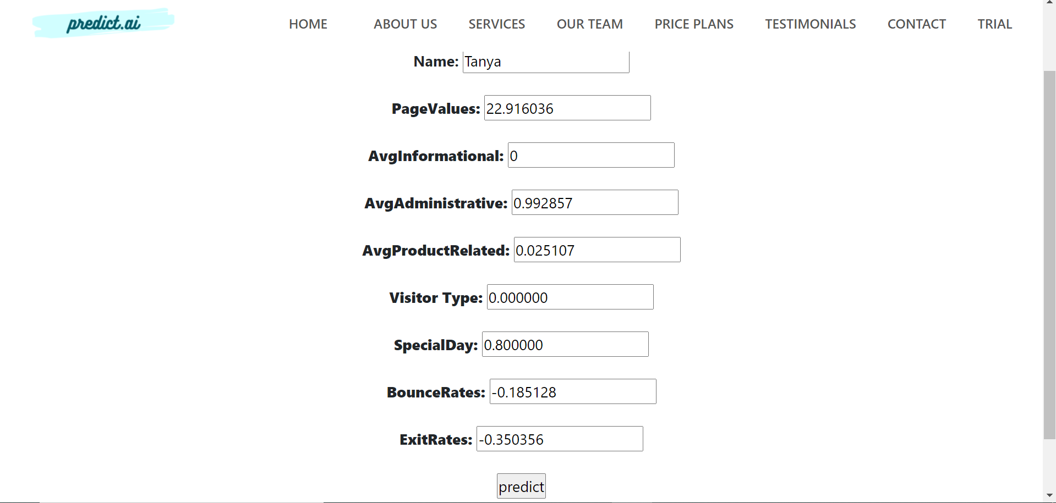
SNEAK PEEK - HOME

Slide 15
SNEAK PEEK - DATA INPUT

Slide 16

SNEAK PEEK - DATA OUTPUT

Slide 17


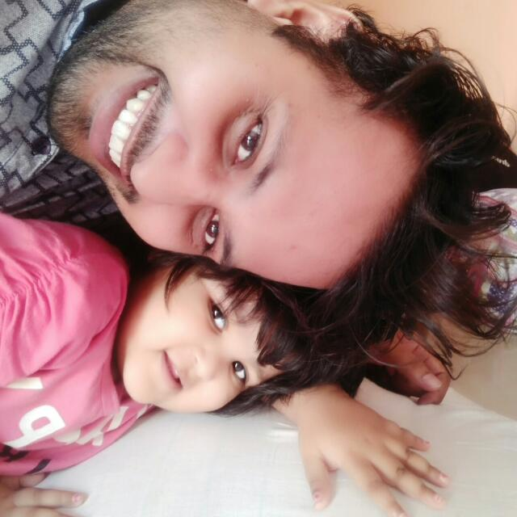
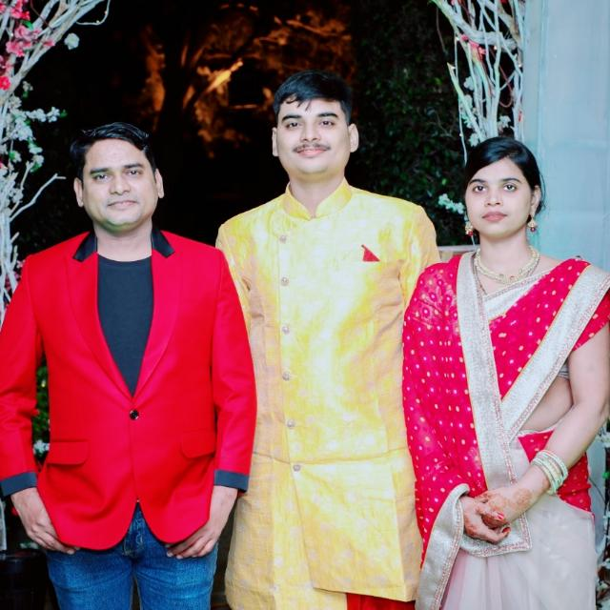

OUR TEAM
Tanya Gupta
Srihit Bharadwaj
Mudit Sand
Web Developer, UI/UX Designer
Data Scientist
Marketing Head
Jaykumar Gupta
Bavish K
Business Lead
Machine Learning Researcher

Slide 18
THANK YOU
Do you have any questions?
Website: www.predictai.design

